Slide 1
Software Engineering BCA IV SEM
Software Design
Bijay Babu Regmi
bijay.regmi@deerwalk.edu.np

Slide 2
Structure Chart
Structure Chart represent hierarchical structure of modules. It breaks down the entire system into lowest functional modules, describe functions and sub-functions of each module of a system to a greater detail.
Structure Chart partitions the system into black boxes (functionality of the system is known to the users but inner details are unknown). Inputs are given to the black boxes and appropriate outputs are generated.
Modules at top level called modules at low level. Components are read from top to bottom and left to right. When a module calls another, it views the called module as black box, passing required parameters and receiving results.

Slide 3
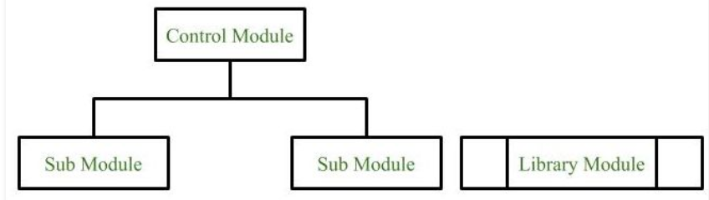
Symbols used in Structure Chart
1. Module
It represents the process or task of the system. It is of three types.
-Control Module
A control module branches tomore than one sub module.
-Sub Module
Sub Module is a module which is the part (Child) of another module.
-Library Module
Library Module are reusable and invokable from any module.

Slide 4
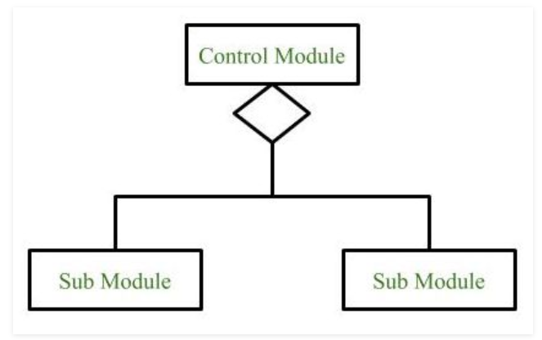
Continued....
2. Conditional Call
It represents that control module can select any of the sub module on the basis of some condition.

Slide 5
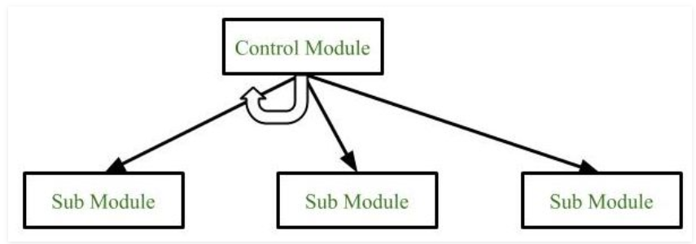
Continued....
3. Loop (Repetitive call of module)
It represents the repetitive execution of module by the sub module.
A curved arrow represents loop in the module.
All the sub modules cover by the loop repeat execution of module.

Slide 6
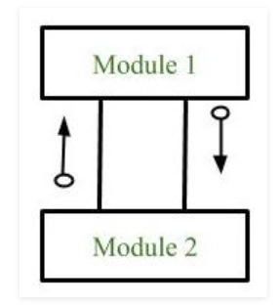
Continued....
4. Data Flow
It represents the flow of data between the modules. It is represented by directed arrow with empty circle at the end.

Slide 7
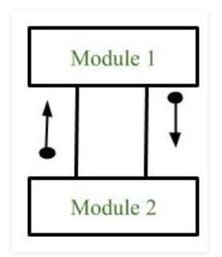
Continued....
5. Control Flow
It represents the flow of control between the modules. It is represented by directed arrow with filled circle at the end.

Slide 8
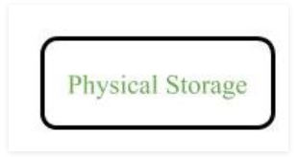
Continued....
6. Physical Storage
Physical Storage is that where all the information are to be stored.

Slide 9
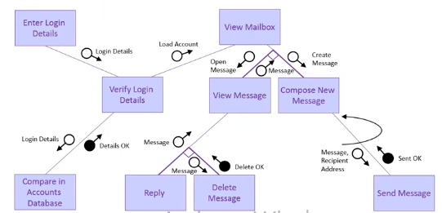
Example (Email Server)

Slide 10
User Interface Design
User interface is the front-end application view to which user interacts in order to use the software. User can manipulate and control the software as well as hardware by means of user interface. User interface is part of software and is designed such a way that it is expected to provide the user insight of the software. UI provides fundamental platform for human-computer interaction.
UI can be graphical, text-based, audio-video based, depending upon the underlying hardware and software combination. UI can be hardware or software or a combination of both.The software becomes more popular if its user interface is:
Attractive
Simple to use
Responsive in short time
Clear to understand
Consistent on all interface screens

Slide 11
UI Design Principles
Structure: Design should organize the user interface purposefully, in the meaningful and usual based on precise, consistent models that are apparent and recognizable to users, putting related things together and separating unrelated things, differentiating dissimilar things and making similar things resemble one another. The structure principle is concerned with overall user interface architecture.
Simplicity: The design should make the simple, common task easy, communicating clearly and directly in the user's language, and providing good shortcuts that are meaningfully related to longer procedures.
Visibility: The design should make all required options and materials for a given function visible without distracting the user with extraneous or redundant data.
Feedback: The design should keep users informed of actions or interpretation, changes of state or condition, and bugs or exceptions that are relevant and of interest to the user through clear, concise, and unambiguous language familiar to users.
Tolerance: The design should be flexible and tolerant, decreasing the cost of errors and misuse by allowing undoing and redoing while also preventing bugs wherever possible by tolerating varied inputs and sequences and by interpreting all reasonable actions.

Slide 12
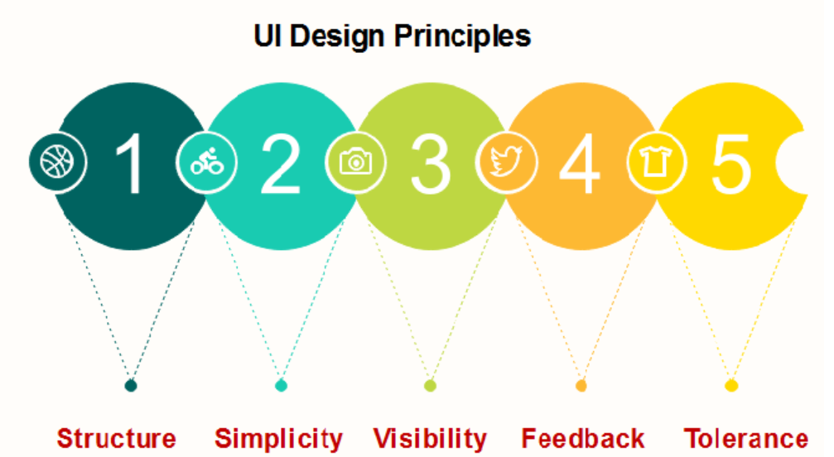
Continued....

Slide 13
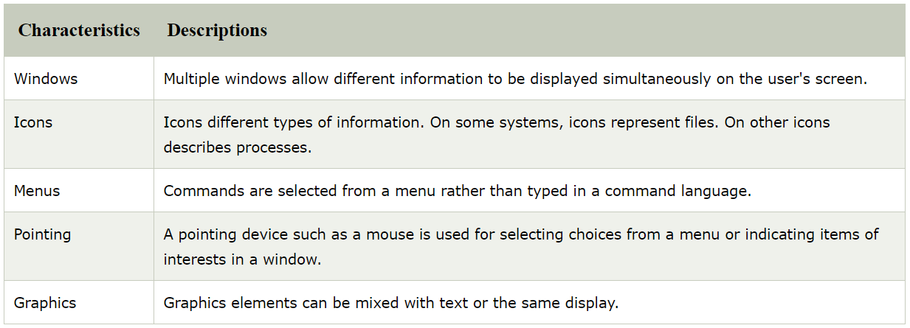
Continued....
There are two types of User Interface:
- Graphical User Interface
- Command Line Interface
Graphical User Interface
Graphical User Interface provides the simple interactive interface to interact with the system. GUI can be a combination of both hardware and software. Using GUI, user interprets the software. It relies much more heavily on the mouse. A typical example of this type of interface is any versions of the Windows operating systems.
The characteristics of Graphical User Interface are:

Slide 14
Continued....
Advantages:
Less expert knowledge is required to use it.
Easier to Navigate and can look through folders quickly in a guess and check manner.
The user may switch quickly from one task to another and can interact with several different applications.
Disadvantages:
Typically decreased options.
Usually less customizable. Not easy to use one button for tons of different variations.

Slide 15
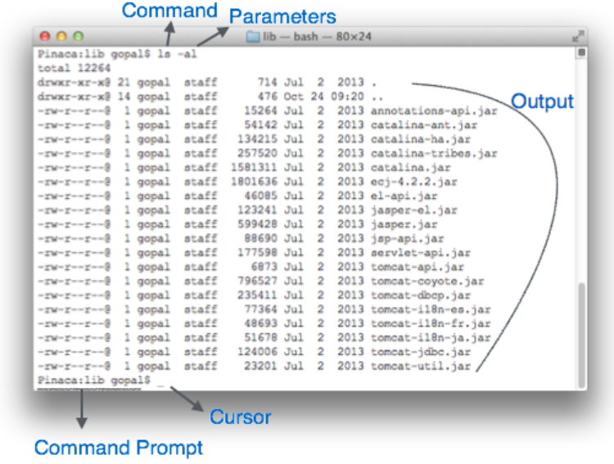
Command Line Interface
Command Line Interface provides a command prompt, where the user types the command and feeds to the system. The user needs to remember the syntax of the command and its use. This method relies primarily on the keyboard. A typical example of this is UNIX.

Slide 16
Continued....
A text-based command line interface can have the following elements:
Command Prompt - It is text-based notifier that is mostly shows the context in which the user is working. It is generated by the software system.
Cursor - It is a small horizontal line or a vertical bar of the height of line, to represent position of character while typing. Cursor is mostly found in blinking state. It moves as the user writes or deletes something.
Command - A command is an executable instruction. It may have one or more parameters. Output on command execution is shown inline on the screen. When output is produced, command prompt is displayed on the next line.

Slide 17
Continued....
Advantages:
Many and easier to customizations options.
Typically capable of more important tasks.
Disadvantages:
Relies heavily on recall rather than recognition.
Navigation is often more difficult.

Slide 18
Human Computer Interaction
Human-computer interaction (HCI) is a multidisciplinary field of study focusing on the design of computer technology and, in particular, the interaction between humans (the users) and computers. While initially concerned with computers, HCI has since expanded to cover almost all forms of information technology design.
Human Computer Interface (HCI) was previously known as the man-machine studies or man-machine interaction. It deals with the design, execution and assessment of computer systems and related phenomenon that are for human use.
HCI can be used in all disciplines wherever there is a possibility of computer installation. Some of the areas where HCI can be implemented with distinctive importance are mentioned below −
Computer Science − For application design and engineering.
Psychology − For application of theories and analytical purpose.
Sociology − For interaction between technology and organization.
Industrial Design − For interactive products like mobile phones, microwave oven, etc.

Slide 19
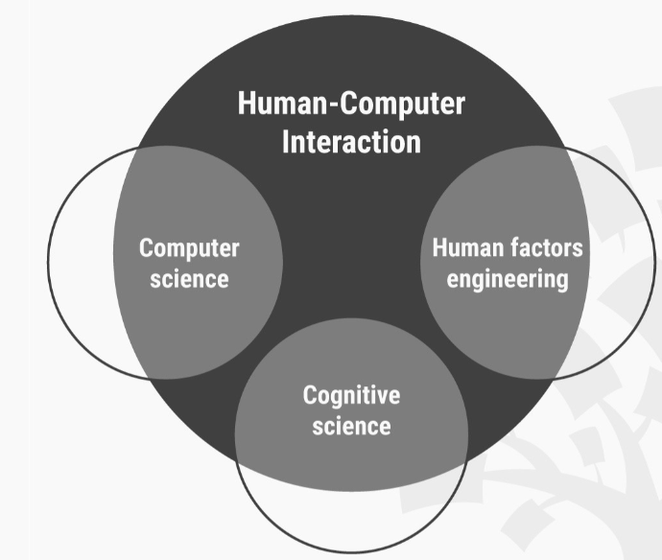
Multidisciplinary Field of HCI

Slide 20
Continued....
The intention of this subject is to learn the ways of designing user-friendly interfaces or interactions. Considering which, we will learn the following −
Ways to design and assess interactive systems.
Ways to reduce design time through cognitive system and task models.
Procedures and heuristics for interactive system design.

Slide 21
History of Human Computer Interaction
It’s perhaps easy to see that until the mid to late 1970s this discipline wasn’t particularly important. The few people who had access to computers were academics or professionals with a few incredibly dedicated (and wealthy) hobbyists thrown into the mix. Without a broad base of users; it wasn’t necessary to focus on how those users interacted with computers – they just made do with whatever was to hand or created what they needed themselves.

Slide 22
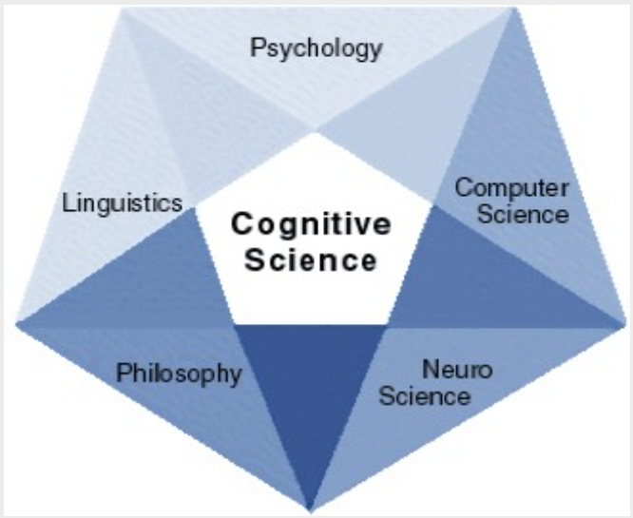
Continued....
Cognitive Science
Luckily, for the masses, there was a discipline waiting in the wings to help with the tasks that lay ahead. Cognitive sciences (a broad and heady mix which includes psychology, language, artificial intelligence, philosophy and even anthropology) had been making steady progress during the 1970s and by the end of the decade they were ready to help articulate the systems and science required to develop user interfaces that worked for the masses.

Slide 23
Continued....
Engineering
This is known as “cognitive engineering” e.g. building things that work with our thoughts. And once again the engineering discipline had also come on leaps and bounds during the 1970s in order to support this change. In aviation, for example, engineering had already started to simplify the user interface of complex airplanes. It was natural for some of this work to move into the UI field for computing devices.
Documentation
It’s also important to recognize the challenge of documenting these developments. New systematic approaches needed to be taken in order to record developments and to share these with other practitioners of the new discipline worldwide. There really is, after all, no advantage in reinventing the mouse over and over again.

Slide 24
Information Presentation
Information presentation is concerned with presenting system information to system users
The information may be presented directly (e.g. text in a word processor) or may be transformed in some way for presentation (e.g. in some graphical form)
The Model-View-Controller approach is a way of supporting multiple presentations of data

Slide 25
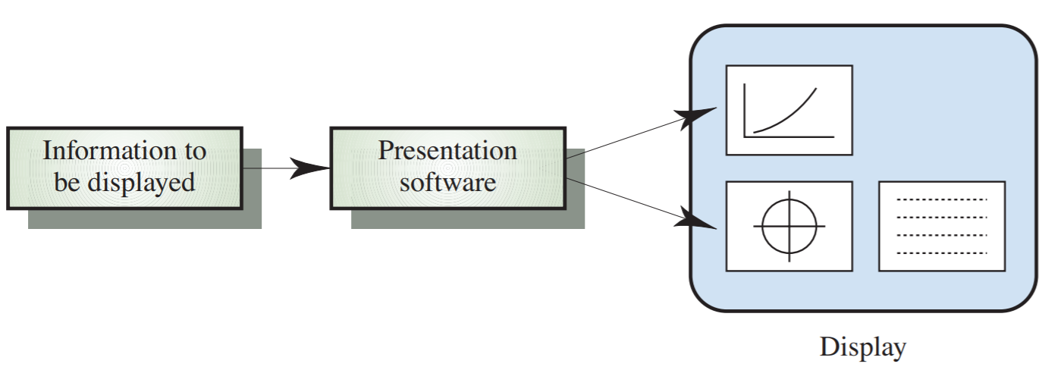
Continued....

Slide 26
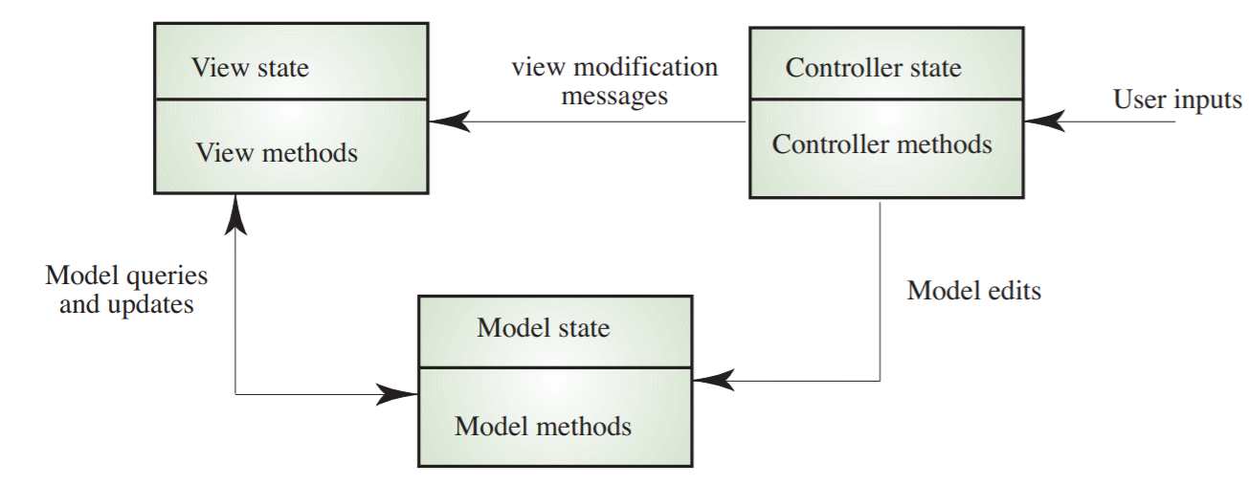
Mode View Controller

Slide 27
Continued....
Static information
- Initialised at the beginning of a session. It does not change during the session
- May be either numeric or textual
Dynamic information
- Changes during a session and the changes must be communicated to the system user
- May be either numeric or textual
Information Display Factors:
Is the user interested in precise information or data relationships?
How quickly do information values change?
Must the change be indicated immediately?
Must the user take some action in response to a change?
Is there a direct manipulation interface?
Is the information textual or numeric? Are relative values important?

Slide 28
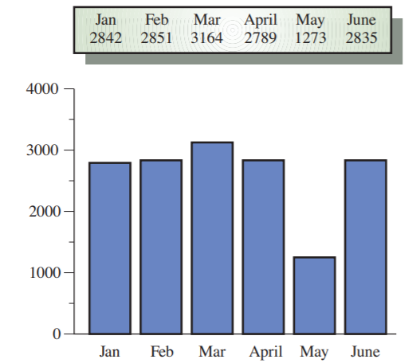
Alternative Information Presentation

Slide 29
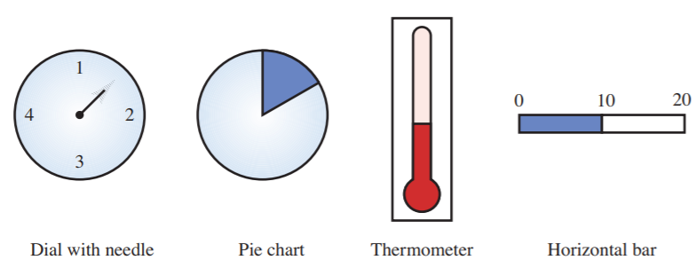
Analogue vs Digital Presentation
Digital presentation
- Compact - takes up little screen space
- Precise values can be communicated
Analogue presentation
- Easier to get an 'at a glance' impression of a value
- Possible to show relative values
- Easier to see exceptional data values
Dynamic Information Display

Slide 30
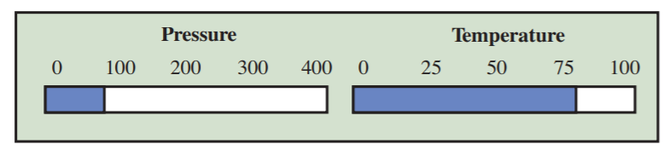
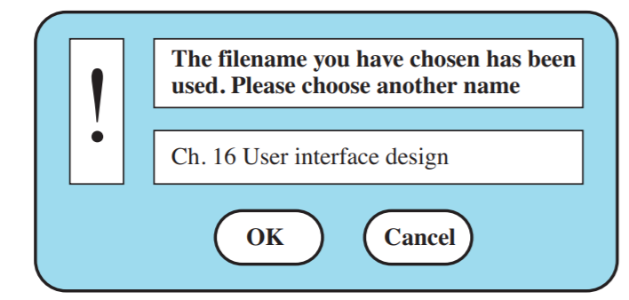
Continued....
Displaying Relative Values
Textual Highlighting

Slide 31
Data Visualisation
Concerned with techniques for displaying large amounts of information
Visualisation can reveal relationships between entities and trends in the data
Possible data visualisations are:
- Weather information collected from a number of sources
- The state of a telephone network as a linked set of nodes
- Chemical plant visualised by showing pressures and temperatures in a linked set of tanks and pipes
- A model of a molecule displayed in 3 dimensions
- Web pages displayed as a hyperbolic tree

Slide 32
Continued....
Colour displays
Colour adds an extra dimension to an interface and can help the user understand complex information structures
Can be used to highlight exceptional events
Common mistakes in the use of colour in interface design include:
- The use of colour to communicate meaning
- Over-use of colour in the display
Colour Use Guidelines
Don't use too many colours
Use colour coding to support use tasks
Allow users to control colour coding
Design for monochrome then add colour
Use colour coding consistently
Avoid colour pairings which clash
Use colour change to show status change
Be aware that colour displays are usually lower resolution

